Slide 1
INSPIRE GeoDCAT-AP Pilot
Analysis of potential metadata information losses
in the ISO-to-GeoDCAT-AP transformation
Paloma Abad (Spain) /Jordi Escriu (JRC)
Pilot Phase 2 - Working Team T-1B Kick-off meeting
February 26, 2026

Slide 2
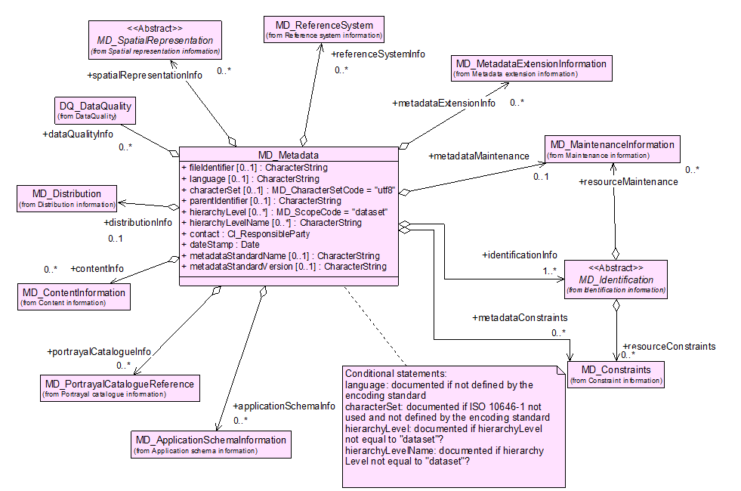
Analysis of potential metadata information losses in the ISO-to-GeoDCAT-AP transformation
Analyse which are the commonly used ISO 19115 metadata elements which are absent from GeoDCAT- AP 3.1.0.
The work will take into account the mandatory, conditional, and optional elements.
Metadata entity set information

Slide 3
Analysis of potential metadata information losses in the ISO-to-GeoDCAT-AP transformation
The work will consist of:
Reviewing the 19115 standard.
Make suggestions to include in the mapping ISO metadata elements that might be essential and are currently not present in GeoDCAT-AP.
MD_Metadata | Metadata entity set information
MD_Identification | Identification information
MD_Constraints | Constraint information
DQ_DataQuality | Data quality information
MD_MaintenanceInformation | Maintenance information
MD_SpatialRepresentation | Spatial representation information
MD_ReferenceSystem | Reference system information
MD_ContentInformation | Content information
MD_PortrayalCatalogueReference | Portrayal catalogue information
MD_Distribution | Distribution information
MD_MetadataExtensionInformation | Metadata extension information
MD_ApplicationSchemaInformation | Application schema information
EX_Extent | Extent information
CI_Citation CI_ResponsibleParty | Citation and responsible party information
Metadata entities

Slide 4
Identification information (MD_Identification)
MD_DataIdentification
It contains information to uniquely identify the data. Particularly, it includes information about the citation for the resource, an abstract, the purpose, the credits, the status and points of contact.
The MD_Identification entity is mandatory.
Example
MD_Format, format of the data MD_BrowseGraphic, graphic overview of the data MD_Usage, specific uses of the data MD_Constraints, constraints placed on the resource MD_Keywords, keywords describing the resource MD_MaintenanceInformation, how often the data is scheduled to be updated and the scope of the update MD_AggregateInformation, information about datasets that are aggregate parts of the dataset that the metadata describes
MD_ServiceIdentification
Provides a high-level description of a service. See ISO 19119 for further information.
Metadata entities

Slide 5
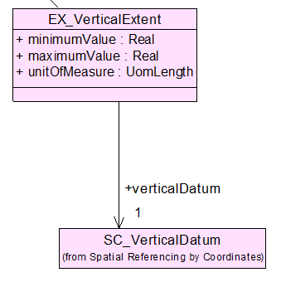
Identification information (MD_Identification)
MD_DataIdentification
The temporal and vertical extent of the data might not be included in GeoDCAT-AP.
There might be room for improving GeoDCAT-AP.
Example
EX_VerticalExtent vertical domain of dataset
EXAMPLE
In GeoDCAT-AP, spatial resolution is included as:
dcat:spatialResolutionInMeters
In ISO, there are other types ways for expressing the spatial resolution:
as equivalent scale
as angular distance
as vertical distance
Metadata entities

Slide 6
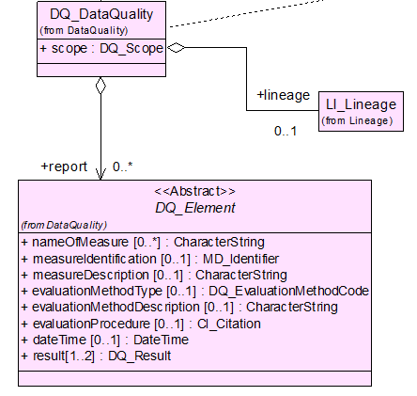
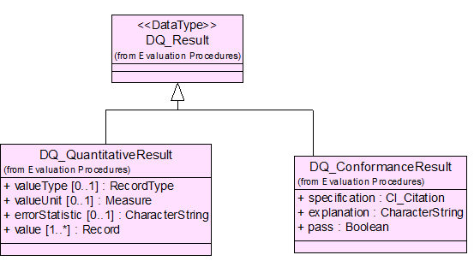
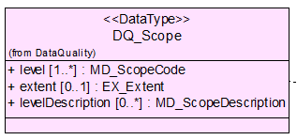
Example
Data quality information (DQ_DataQuality)
The DQ_DataQuality entity contains a general assessment of the quality of the dataset.
It is optional and contains the scope of the quality assessment.
DQ_DataQuality is an aggregate of LI_Lineage and DQ_Element.
Although in ISO and INSPIRE the quality with which the data has been created is optional, it is very valuable information that allows us to know the reliability and provides confidence.
Metadata entities

Slide 7
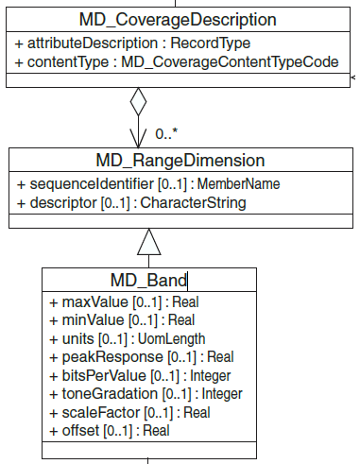
Discussion: Scope of the work
Should we analyse all metadata elements in ISO 19115?
For example:
MD_CoverageDescription: information about the content of a grid data cell
Image description: information identifying the feature catalogue
Range dimension
Band
MD_Feature Catalogue description
Should we analyse only those elements that are mostly used in all metadata records?
For example:
MD_Distribution, DQ_DataQuality…

Slide 8
Working methodology:
The core metadata elements are already mapped on GeoDCAT-AP 3.1.0. See https://semiceu.github.io/GeoDCAT-AP/releases/3.1.0/#inspire-and-iso-19115-mappings
Dataset title (M) | Spatial representation type (O)
Dataset reference date (M) | Reference system (O)
Dataset responsible party (O) | Lineage statement (O)
Geographic location of the dataset (by four coordinates or by geographic identifier) (C) | On-line resource (O)
Dataset language (M) | Metadata file identifier (O)
Dataset character set (C) | Metadata standard name (O)
Dataset topic category (M) | Metadata standard version (O)
Scale of the dataset (O) | Metadata language (C)
Abstract describing the dataset (M) | Metadata character set (C)
Dataset format name (O) | Metadata point of contact (M)
Dataset format version (O) | Metadata date stamp (M)
Additional extent information for the dataset (vertical and temporal) (O)
This includes bindings for metadata elements of the INSPIRE metadata, metadata elements in the core of [ISO-19115] for which DCAT-AP provides an RDF syntax binding.

Slide 9
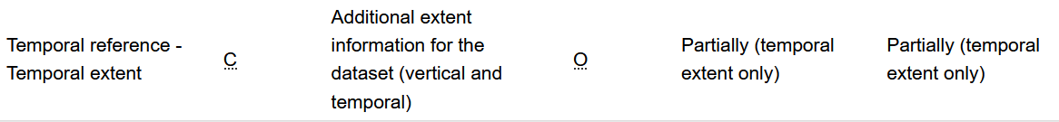
Working methodology:
Check GeoDCAT-AP Extended:
The alignments for INSPIRE and [ISO-19115] metadata elements that are not included in GeoDCAT-AP Core are defined in GeoDCAT-AP Extended.
See: https://semiceu.github.io/GeoDCAT-AP/releases/3.1.0/#overview-of-bindings-for-geodcat-ap-extended
The cardinality and controlled lists in those mappings
Compile the list of ISO metadata element losses in the ISO-to-GeoDCAT-AP SEMIC XSLT transformation.
Example

Slide 10
How are we going to work?
You can report through the SEMIC GeoDCAT-AP GitHub repository any metadata elements that you think are missing.
If possible, please warn about it through email to (paloma.abad@cnig.es, berta.carrion@cnig.es, jordi.escriu@ec.europa.eu)
You can include the metadata elements in the share Excel file.
Example
ISO 19115:2003 | DQ_Element | type of test applied to the data specified by a data quality scope
 | nameOfMeasure | name of the test applied to the data
ISO 19115 path | ./dataQuality/DQ_Element
 | measureIdentification | code identifying a registered standard procedure
ISO 19115 path | ./dataQuality/DQ_Element
 | measureDescription | description of the measure being determined
ISO 19115 path | ./dataQuality/DQ_Element
 | evaluationMethodType | type of method used to evaluate quality of the dataset
ISO 19115 path | ./dataQuality/DQ_Element
 | evaluationMethodDescription | description of the evaluation method
ISO 19115 path | ./dataQuality/DQ_Element

Slide 11
Work Plan
Other volunteers to participate in the work are welcome at any stage, especially when starting the work.
By end of March 2026: The Excel file containing the potential metadata information losses in the ISO-to-GeoDCAT-AP transformation in a public location.
By End of April 2026: Final list of metadata elements.
Each month: T-1B working meeting to share progress, report results and get feedback from the INSPIRE community.
Bi-monthly: General pilot meeting, sharing progress and high-level concerns in the context of all working teams.

